Slide 1

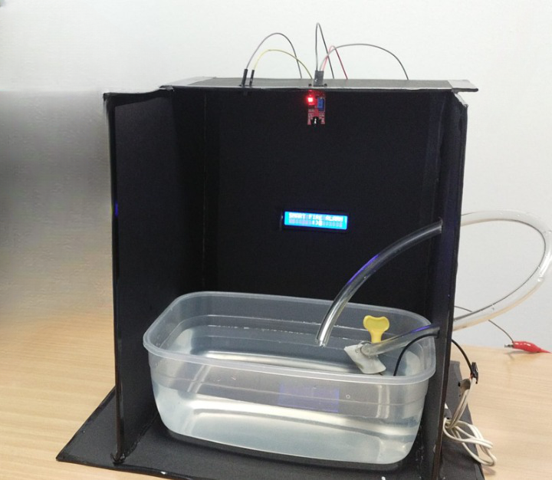
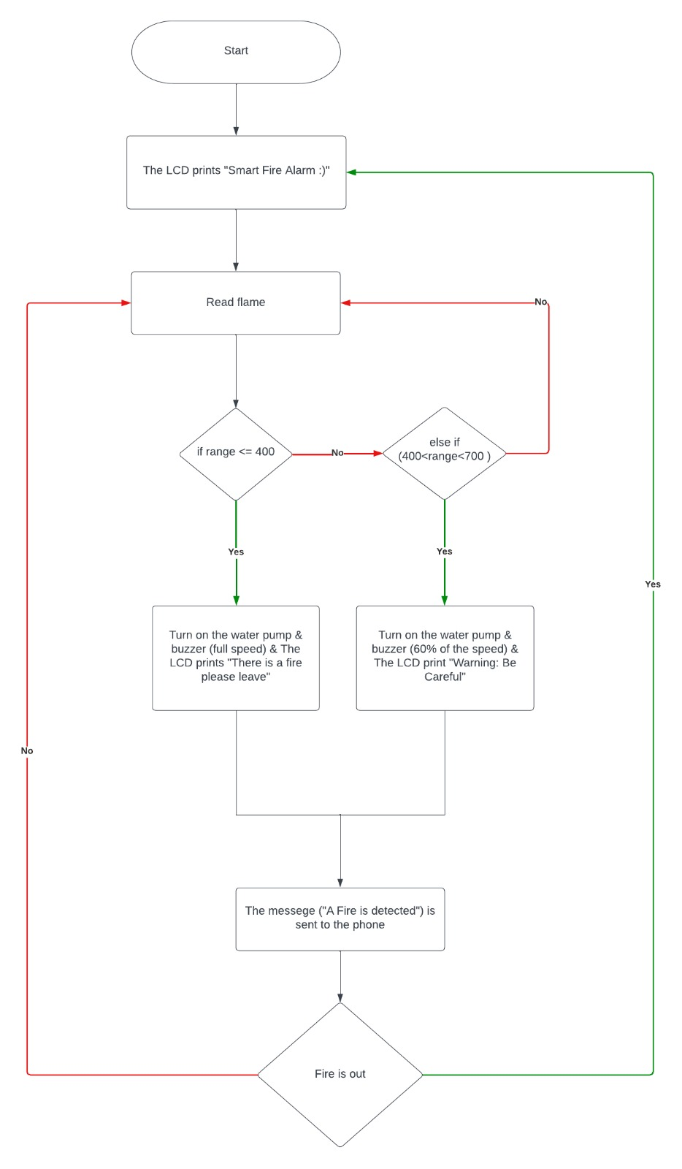
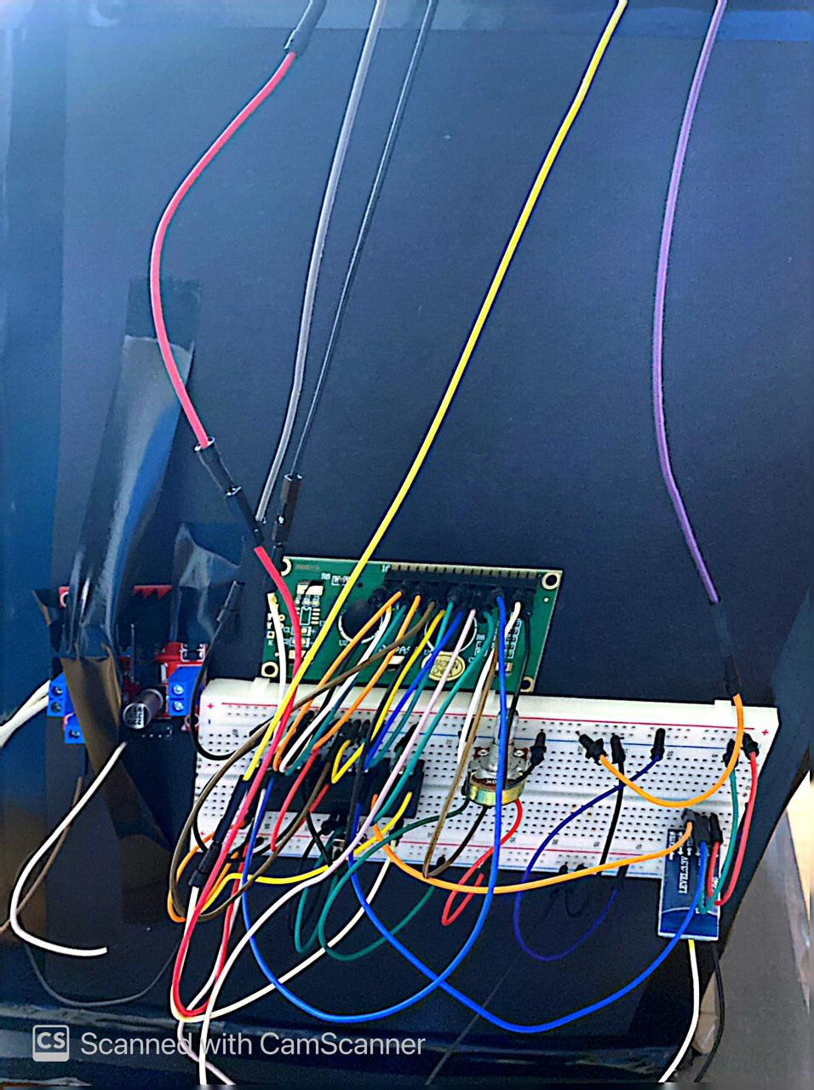
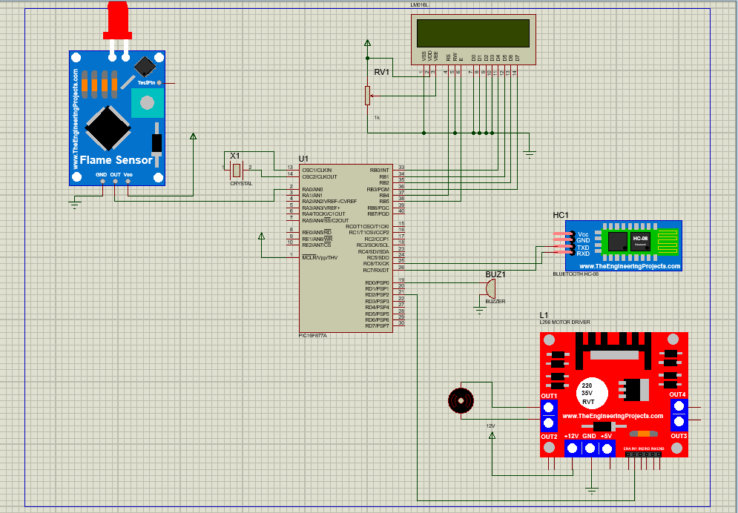
Title that hints at the underlying issue or project purpose/goal
Y.Masalha, A.Alqudah, A.Bader
Supervisor: Dr. Belal Sababha
Embedded Systems Final Design Project, Spring 2023
King Abdullah II School of Engineering
Princess Sumaya University for Technology
Introduction
Our innovative system utilizes a flame sensor to detect flames of varying intensities, enabling effective fire detection and response. By analyzing the flame's strength, our system adjusts the sound of a buzzer and the water pressure from a pump accordingly. Additionally, we have incorporated serial communication, which sends instant notifications to a connected phone when a fire is detected. This integrated solution ensures prompt and tailored action in the event of a fire hazard.
Results
As a result the fire detection system implemented using a utilizes various components such as flame sensors, LCD display, PWM (Pulse Width Modulation) control, and serial communication.
The program continuously reads the flame intensity using analog-to-digital conversion. Based on the flame level, it adjusts the PWM output to control the buzzer sound and water pump strength. It also updates an LCD display to show appropriate messages corresponding to different flame intensities.
Additionally, the program includes an interrupt service routine (ISR) that handles timing events. It triggers periodic updates of the LCD display and sends notifications via USART for connected phones in case of fire detection.
The code initializes and configures the necessary peripherals such as ADC, USART, and timers for proper operation.
Design
Components used were a 16F877A microcontroller that interfaces a KY-026 flame sensor, making a buzzer and a water pump that is connected to an H-Bridge to either turn on or off. We also added an LCD display that is connected to a potentiometer which shows different messages depending on the flame’s state. An HC-06 Bluetooth card was used for serial communication.
Figure 3: Front View
Figure 1: Flow Chart
Figure 2: Schematic Electrical Design
Figure 4: Back View
Conclusion
In summary, our flame detection system represents a significant advancement in fire safety technology. By utilizing a flame sensor to detect varying intensities of flames, it offers tailored response capabilities through adjustments in the buzzer sound and water pressure. The incorporation of serial communication enables real-time notifications to connected phones, ensuring prompt awareness and response. With its potential to enhance fire safety measures and minimize damage, our system holds great significance in protecting lives and properties.

